Slide 1
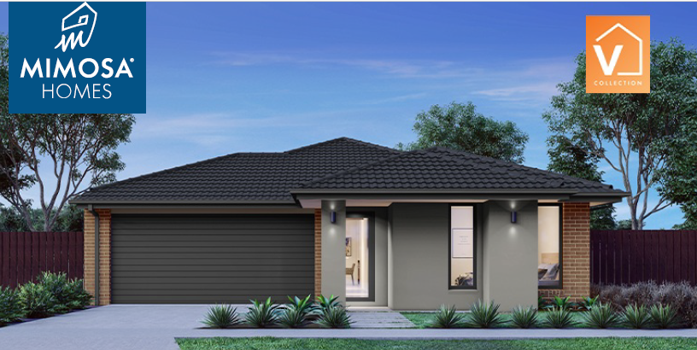
$605,900
HOUSE & LAND PACKAGE
Home Size: 16.1SQ
V BOHO 161
Lot Size: 313M2
3
2
2
LOT 104
HOUSE FEATURES
Inclusive of site cost & connections with H1 class slab as per standard inclusions
2590mm Ceiling Height
LED Downlights in lieu of battens through-out
Laminate Flooring Pack
Kitchen Cabinetry Pack
900mm Appliances
20mm Stone Bench to Kitchen
Dishwasher
Microwave with Trim Kit
Evaporative Cooling - Single Storey
BUILDER DIRECT:
ERICK SUTEDJA 0416 575 858
For further information please call 1300 582 020
or visit the Oaklands Land Sales Centre at
Cnr Plumpton & Beattys Roads, Bonnie Brook
^{oaklandsestate.com.au}

Slide 2
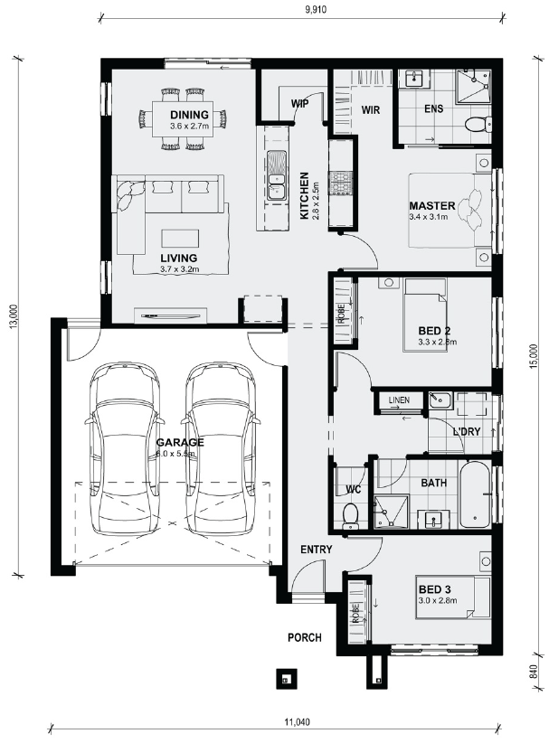
All plans and facades are indicative concepts only and are not intended to be accurate depictions. Mimosa Homes reserves the right to amend plans specifications and price without notice. Package prices are based on a standard facade, standard inclusions, the availability of suitable land for development and does not include developer/estate requirements. Facade and inclusion images shown may not be standard and may not be included in the price of the home. All dimensions are approximate. Package prices do not include landscaping, fencing, decking, planter boxes, driveways and paths unless specified.
$605,900
HOUSE & LAND PACKAGE
V BOHO 161
Home Size: 16.1SQ
Lot Size: 313m²
House and land sold separately. Potter George acts as agent for the sale of the land only. Buyers will need to enter into a separate contract with the builder for the house and the builder is solely responsible for all matters relating to the building contract and the house. Prices may include rebates that are subject to the fulfilment of separate conditions under the land contract and information provided by the builder may be subject to eligibility criteria, terms and conditions as may be imposed by the builder. Buyers should review the land and building contracts carefully, make their own inquiries and obtain independent advice before proceeding. Photographs, illustrations and information are intended to be an aid and are indicative only and believed to be correct at the time of publication. Potter George reserves the right to withdraw or alter any house and land package at any time without notice at its absolute discretion. Potter George makes no representations and gives no warranties about the availability of builder’s product at the time of enquiry and buyers should make their own inquiries with the builder directly. Estimated costs for the house and land are indicative only and other costs and fees are payable, including but not limited to: transfer/stamp duty, settlement/registration fees, legal/conveyancing fees, finance costs, site works, engagement of any consultants, approvals, connection for services and variations. Potter George Pty Ltd.

